Slide 1
British airways
Custom reviews analysis
28.11.2022

Slide 2
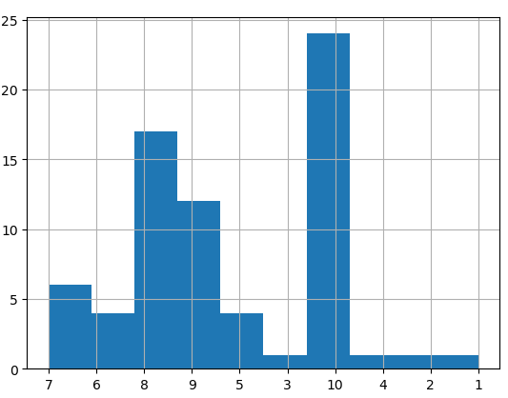
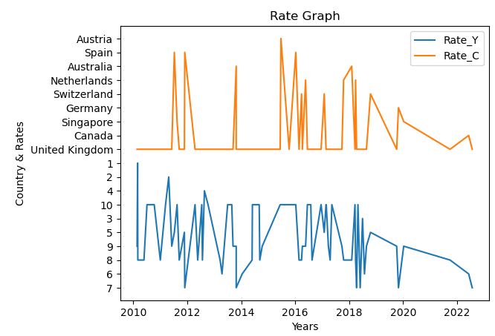
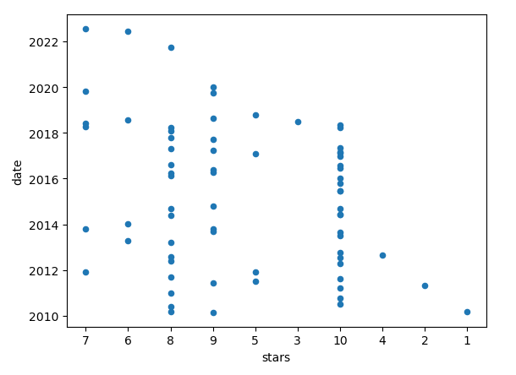
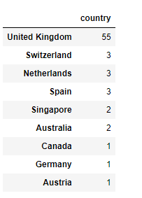
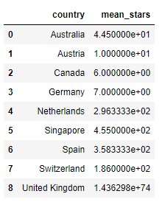
Analysis of data
Total 71 reviews from 9 countries | Canada, Germany have 1 rates but they are more than others. | Big amount of rates from 8-10 is under 2018 year
Most of rating from UK And mean point is Approx. ~ 1,4 | The average point is up with these features and makes up a significant portion of all votes. | its seems customers don’t send feedbacks or company didn’t monitor this works

